Slide 1





React Components
How to Compose in React
JSX
React Components
JSX
component
SoftUni Team
Technical Trainers
component
Software University
http://softuni.bg

Slide 2

Table of Contents
Components
Props
State
Component Lifecycle
Fetching Data

Slide 3
Have a Question?
sli.do #react-js

Slide 4

Components Overview
What are Components, Advantages, Syntax

Slide 5

Components Overview
Components are like JavaScript functions
They are reusable pieces that can be composed
You can customize them with props and state
class Welcome extends React.Component {
render() {
return <h1>Hello, {this.props.name}</h1>;
}
}

Slide 6
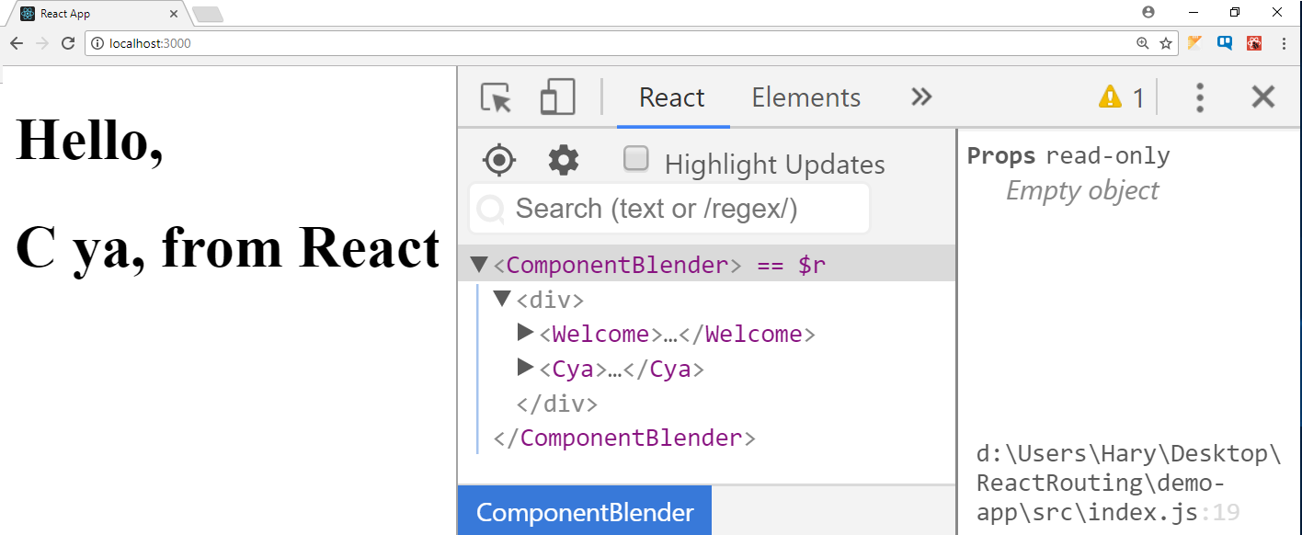

Composition
React components can be nested, like DOM elements
function Welcome() {
return <h1>Hello, from React</h1>;
}
function Cya() {
return <h1>C ya, from React</h1>;
}
function ComponentBlender() {
return (<div>
<Welcome />
<Cya />
</div>);
}
ReactDOM.render(<ComponentBlender />,
document.getElementById('container'));

Slide 7



Advantages
Encapsulate logic
Separate your code
Easier to maintain and debug
Allows reusability
Declarative syntax is easier to reason about
Components are neat

Slide 8

Component Syntax
Names always start with uppercase
Tags must be closed
If there are no children – use self-closing tags
Information is passed via props
<Dropdown> A dropdown list
<UserHead name='homeHeader' />
<Menu>
<MenuItem>Do Something</MenuItem>
<MenuItem>Do Something Fun!</MenuItem>
<MenuItem>Do Something Else</MenuItem>
</Menu>
</Dropdown>;

Slide 9

Component Props
Passing Data, Access and Usage

Slide 10
Component Props
Props is short for properties
Similar to HTML props – used to pass data to components
They should be considered immutable
A component should never modify it's own props!
function Welcome (props) {
return <h1>Hello, {props.name} </h1>;
}
Welcome.defaultProps = { name: "Pesho" };
You may set default properties

Slide 11
Component State
ON
OFF
Storing and Modifying Data

Slide 12
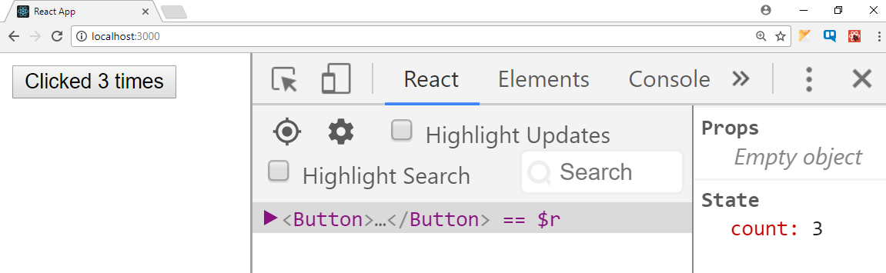
Component State and Initialization
State holds information that can change over time
Usually as a result of user input or system events
class Button extends React.Component {
constructor(props) {
super(props);
this.state = {count: 0};
}
updateCount() {
this.setState((prevState) => { count: prevState.count + 1 });
}
render() {
return (<button onClick={this.updateCount.bind(this)}>
Clicked {this.state.count} times</button>);
}
}

Slide 13
Working With States Overview
State is used with class-based components
Default state can be set in the constructor
To access state
State must never be directly modified
Use this.setState instead
New state will be merged
console.log(this.state[key]);

Slide 14
Working With States Overview
Default state
New State
Access
New State
Update

Slide 15


Component Lifecycle

Slide 16
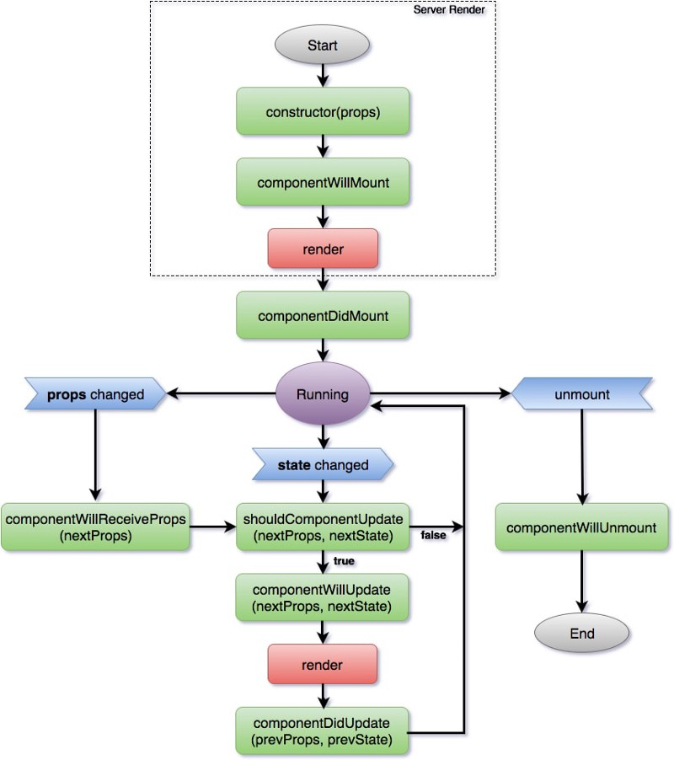
Component Lifecycle
Mounting
Update
Dismounting

Slide 17
constructor() Hook
This method is called on component creation
It's used to initialize state and .bind(this)
class Clicker extends React.Component {
constructor(props) {
super(props);
this.handleClick = this.handleClick.bind(this);
this.state = {
clicks: 0
};
}
handleClick() {
this.setState({
clicks: this.state.clicks + 1
});
}
}

Slide 18
componentWillMount () Hook
This method is executed before a component is added to the DOM
It is recommended that you use the constructor, instead
You should avoid calling functions that cause side effects here
This is the only lifecycle method called on the server.
componentWillMount(){
console.log('I"m the first hoook')
}

Slide 19
componentDidMount() Hook
The hook is triggered after your component has been rendered
This is the point when you should initiate AJAX requests
Its good practice to add here event all your event listeners
Calling setState from this point on will cause a re-render
componetDidMount() {
fetch('https://gitconnected.com')
.then((res) => {
this.setState({
user: res.user
});
});
}

Slide 20
componentWillReciveProps () Hook
React triggers this method when new props will be received
You can check if there are changes in the incoming props
A common use-case for this is resetting state based on a change
componentWillReceiveProps(nextProps) {
if (this.props.id !== nextProps.id) {
this.setState({
feedContent: []
});
}
}

Slide 21
shouldComponentUpdate () Hook
This method provides the ability to cancel new render
This method exists purely for performance improvements
Renders and reconciliations are expensive in React
shouldComponentUpdate(nextProps, nextState) {
return this.props.clicks !== nextProps.clicks;
}

Slide 22
componentWillUpdate () Hook
This method is invoked immediately before rendering
There is not much use for this method
You should probably avoid using it
Don't change the state at this point
componentWillUpdate() {
console.log('I am about to update')
}

Slide 23
componentDidUpdate() Hook
This hook is triggered immediately after React builds new UI
Here is a great place to interact with the DOM
It's a good idea to instantiate a new network request if needed
componentDidUpdate() {
fetch('https://gitconnected.com')
.then((res) => {
this.setState({
user: res.user
});
});
}

Slide 24
componentWillUnmount () Hook
This method is triggered right before the component dismounts
Here you can clean up everything that was associated with the UI
componentWillUnmount() {
window.removeEventListener('resize', this.resizeEventHandler);
}

Slide 25
componentDidCatch () Hook
This method is triggered on error
componentDidCatch(error, info) {
this.setState({ hasError: true });
logErrorToMyService(error, info);
}
render() {
if (this.state.hasError) {
return <h1>Something went wrong.</h1>;
}
return this.props.children;
}
You can log the error to an error reporting service
You can render any custom fallback UI

Slide 26

Fetching Remote Data

Slide 27


Fetch API
The Fetch API provides an interface for fetching resources
This method takes one mandatory argument, the path
It returns a promise that resolves to the Response to that request
You can also pass in an init options object as the second argument
fetch('https://api.github.com/users/xapuu')
.then((data)=>data.json())
.then((d)=>{console.log(d)})
.catch((err)=>{console.log(err)})
(async ()=> {
try{
let d = await fetch('https://api.github.com/users/xapuu')
let forDisplay = await d.json()
console.log(forDisplay)
}catch(e){
console.log('bam')}})()

Slide 28
Summary
We learned what is a component and how to use its params
We understood the component life cycle
We figured out the way to work with fetch

Slide 29







React Components
https://softuni.bg/courses/

Slide 30

License
This course (slides, examples, demos, videos, homework, etc.) is licensed under the "Creative Commons Attribution-NonCommercial-ShareAlike 4.0 International" license

Slide 31





Trainings @ Software University (SoftUni)
Software University – High-Quality Education, Profession and Job for Software Developers
softuni.bg
Software University Foundation
http://softuni.foundation/
Software University @ Facebook
facebook.com/SoftwareUniversity
Software University Forums
forum.softuni.bg

